Slide 1
AIML Regression
Singapore Polytechnic
P2112646
Justin Wong Juin Hng
Singapore Polytechnic

Slide 2
Table of contents
01.
03.
04.
02.
한국 미니멀리스트 스타일의 피치 데크
Problem Breakdown
Modelling & Tuning
You can describe the topic of the section here
You can describe the topic of the section here
Conclusion
Data Manipulation & Exploration
You can describe the topic of the section here
You can describe the topic of the section here
Singapore Polytechnic

Slide 3
01.
Problem Breakdown
한국 미니멀리스트 스타일의 피치 데크
What are the requirements of the problem statement?
Singapore Polytechnic

Slide 4
Problem
Singapore Polytechnic
This dataset contains computer price for different PC models, ranging from Apple, HP, Dell, and others.
We want to build a machine learning model to predict the computer price based on their configuration.
Singapore Polytechnic

Slide 5
02.
Data Manipulation & Exploration
Singapore Polytechnic
Data Cleaning, Feature Engineering and Exploratory Data Analysis (EDA)
Singapore Polytechnic

Slide 6
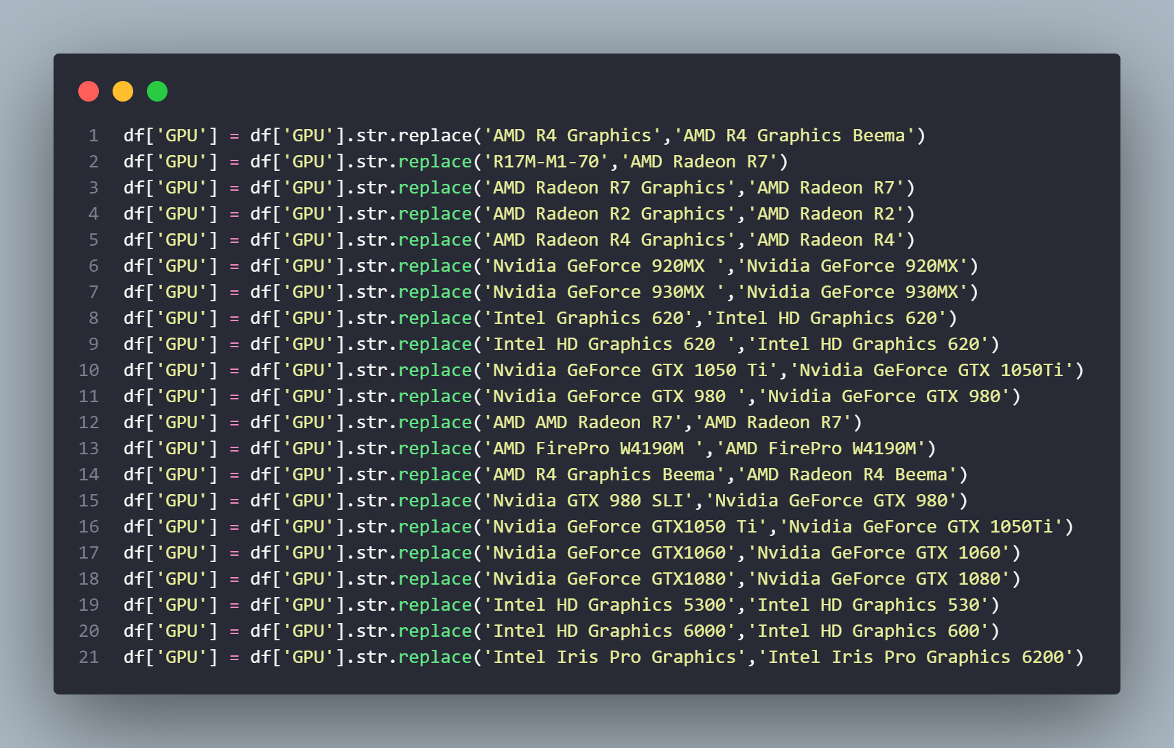
Data Cleaning
Singapore Polytechnic
Data cleaning is the process of fixing or removing incorrect, corrupted, incorrectly formatted, duplicate, or incomplete data within a dataset. When combining multiple data sources, there are many opportunities for data to be duplicated or mislabeled (Tableau, n.d.)
Singapore Polytechnic

Slide 7
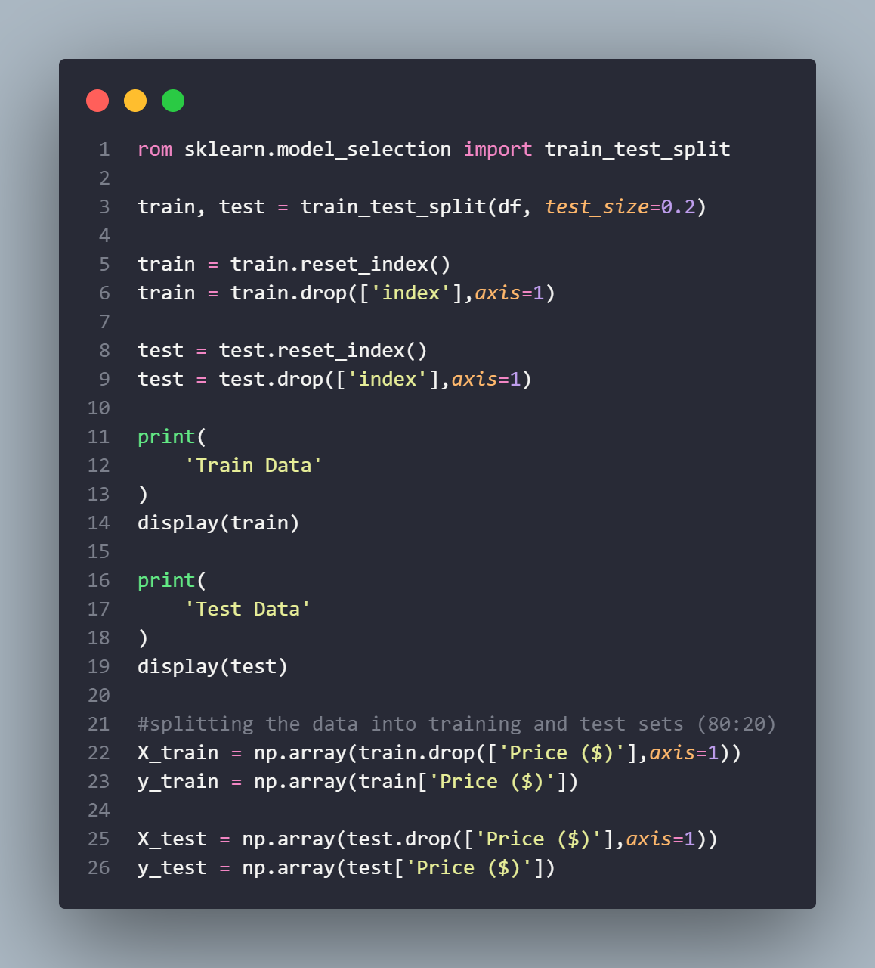
Splitting Data
Singapore Polytechnic
Creating new features to enhance accuracy of model and increase relevance of data.
We split the DataFrame into 2 sets:
Train Data
Test Data
This train-test split procedure is used to estimate the performance of machine learning algorithms when they are used to make predictions on data not used to train the model. (Brownlee, 2020)
Singapore Polytechnic

Slide 8
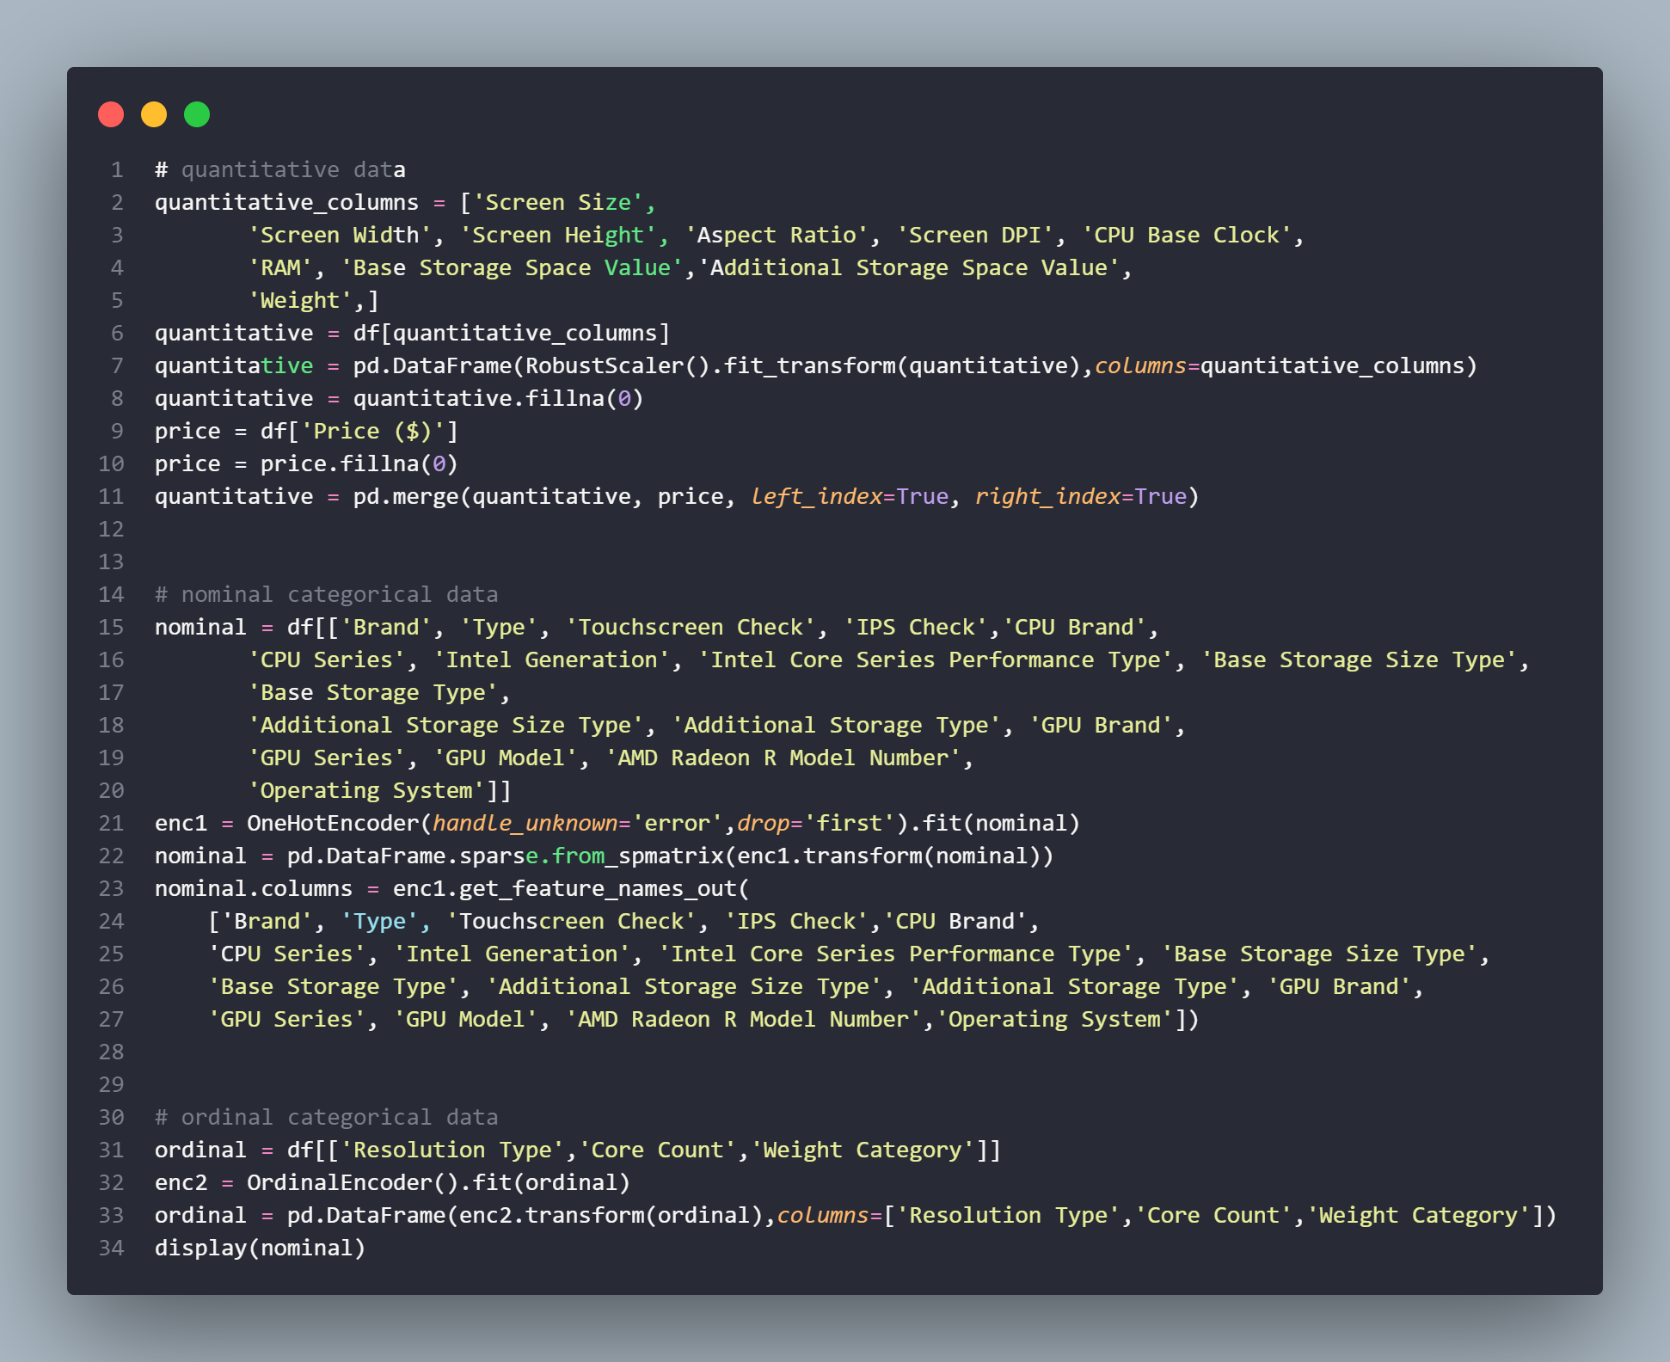
Scaling Data
Singapore Polytechnic
We scale the in 3 ways, quantitative, qualitative nominal and qualitative ordinal.
This allows us to get the most accurate results for their respective data types
Various machine learning algorithms are sensitive when the data is not scaled.
There are various machine learning algorithms that use the same kind of basic strategies as their base concept under the algorithm.
These base concepts are totally based on the mapping of the distance between data points; scaling of the data makes it easy for a model to learn and understand the problem. (Verma, 2021)
Singapore Polytechnic

Slide 9
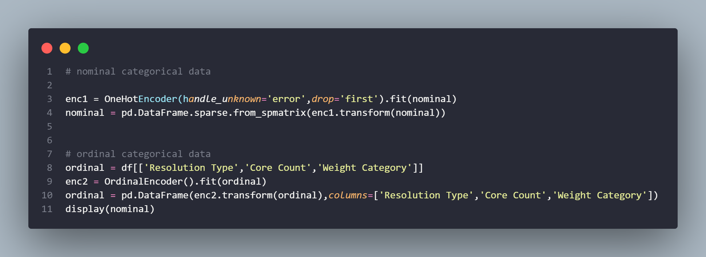
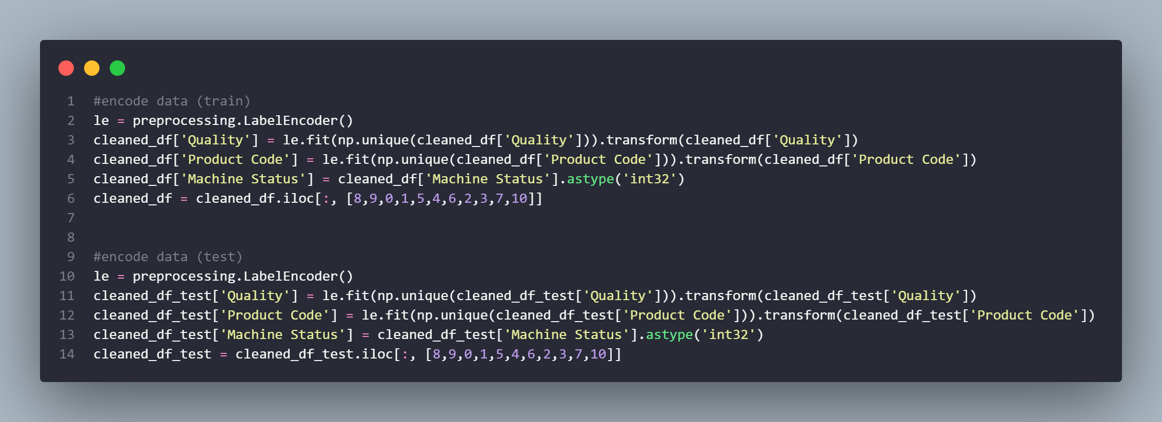
Data Encoding
Singapore Polytechnic
I encoded the ordinal data using OneHotEncoder, and the ordinal data using
OrdinalEncoder.
One hot encoding makes our training data more useful and expressive, and it can be rescaled easily.
By using numeric values, we more easily determine a probability for our values.
In particular, one hot encoding is used for our output values, since it provides more nuanced predictions than single labels. (Fawcett, 2021)
Singapore Polytechnic

Slide 10
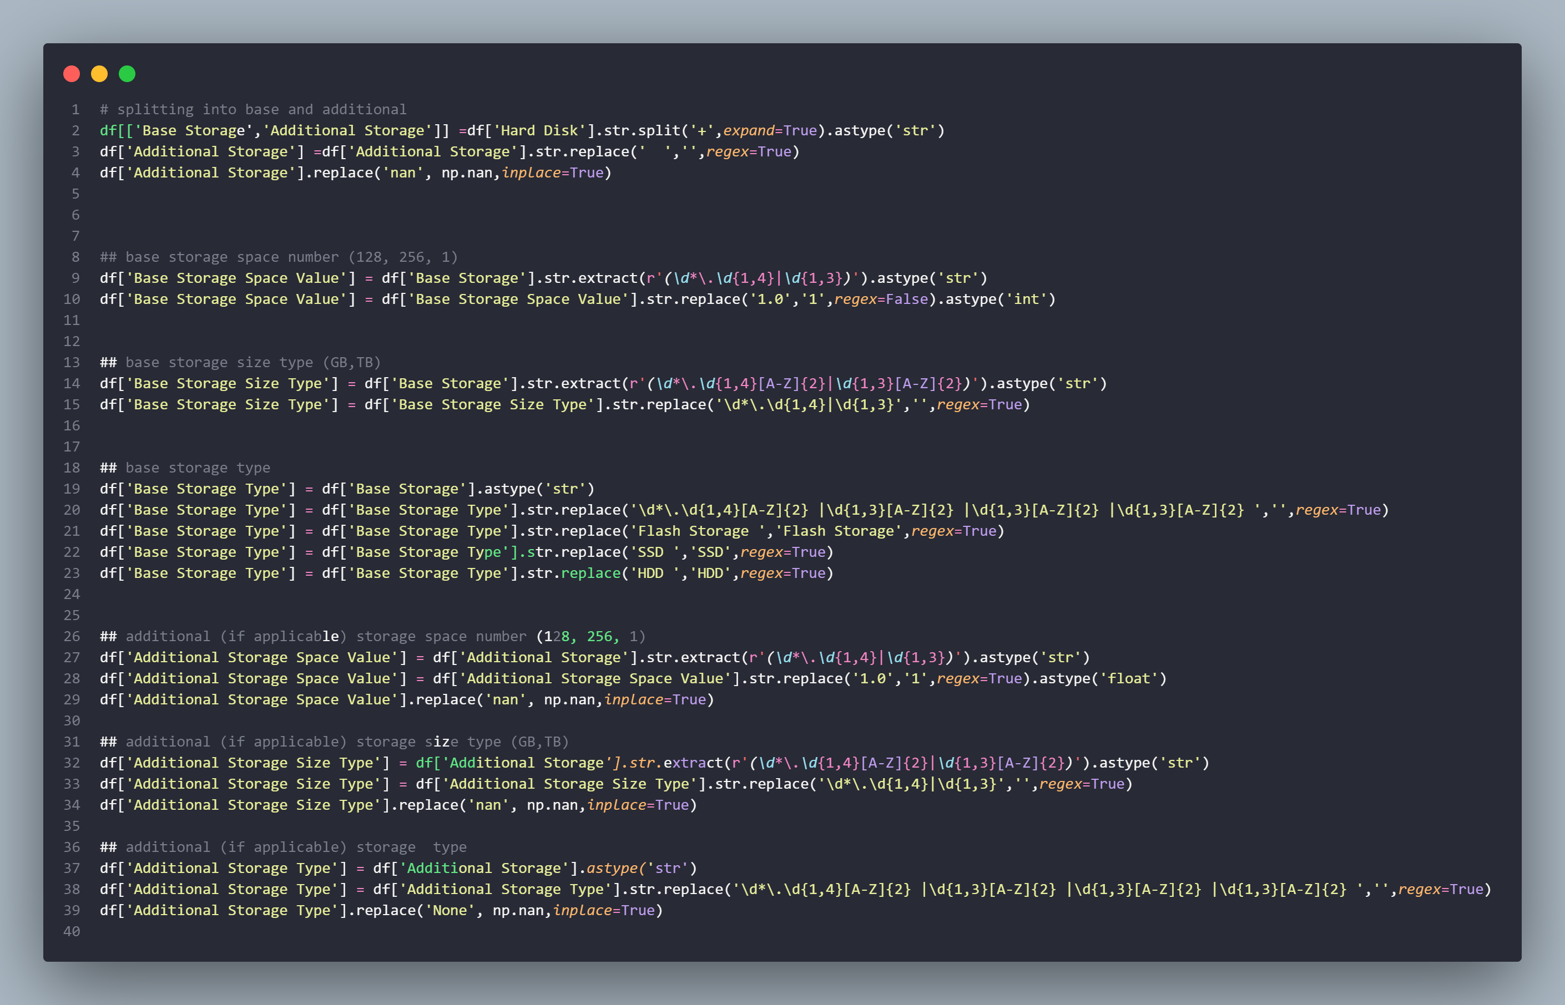
Feature Engineering
Singapore Polytechnic
Creating new features to enhance accuracy of model and increase relevance of data.
I used Regular Expressions (RegEx) to extract multiple features from the raw string data. An example of this would be extracting the base storage type.
The process of designing artificial features into an algorithm. These artificial features are then used by that algorithm in order to improve its performance, or in other words reap better results (Patel, 2021)
Singapore Polytechnic

Slide 11
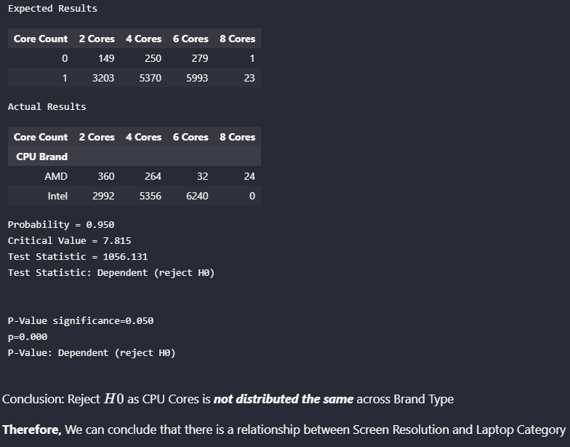
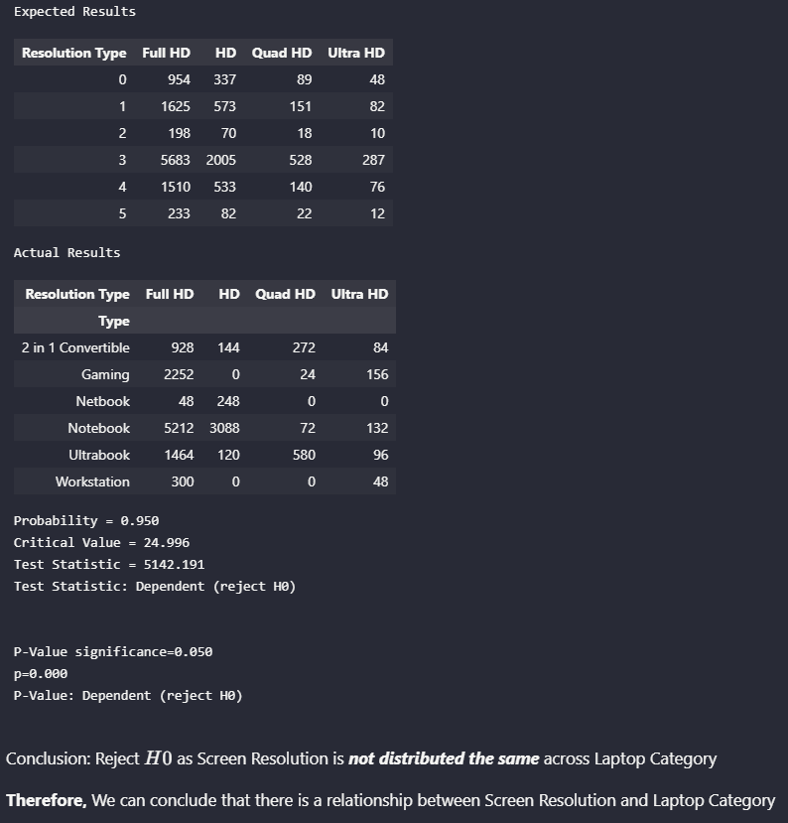
Data Exploration Chi-Square Test for Association
Singapore Polytechnic
Singapore Polytechnic

Slide 12
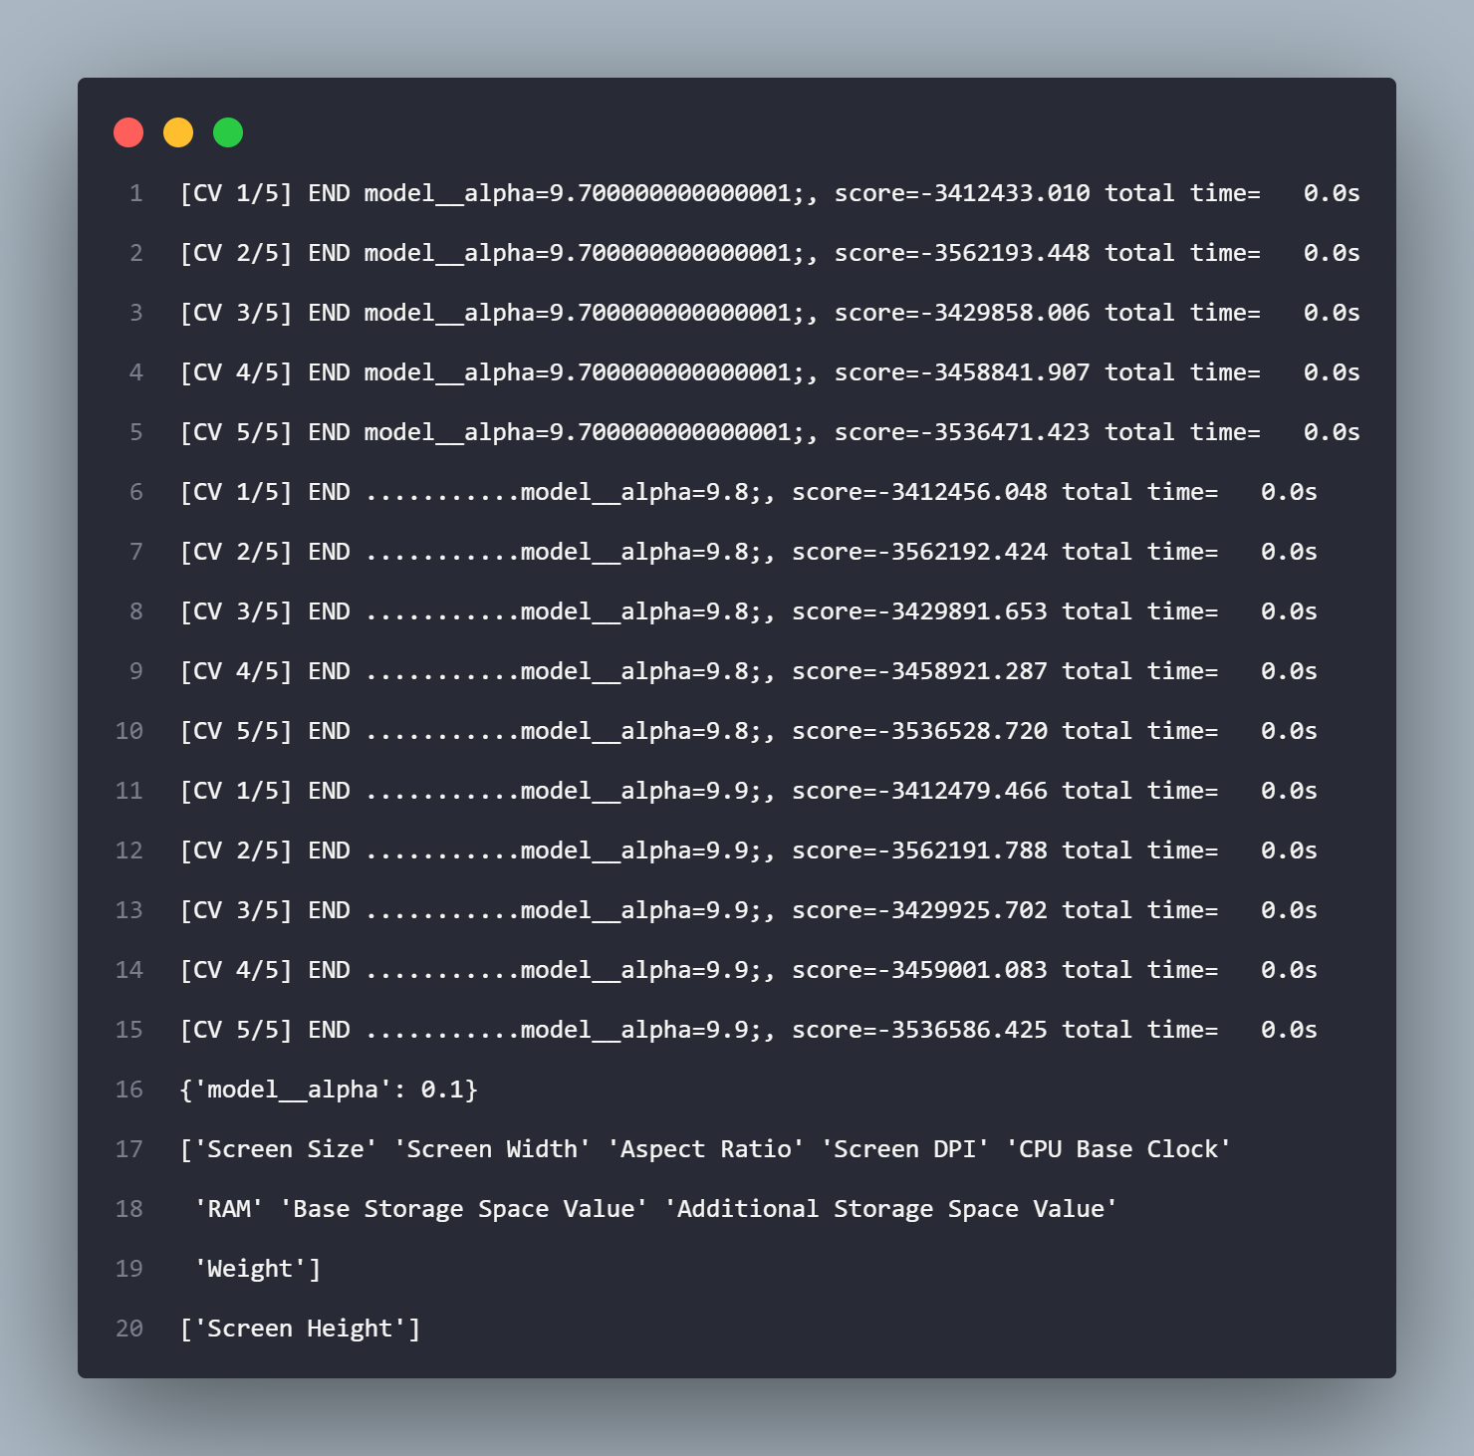
Data Exploration Lasso Regression for Feature Importance Analysis
Singapore Polytechnic
After running a GridSearch for the most optimal Lasso Regression parameters, we can see that important numerical features considered by the model are all the features except for Screen Height
This may be due to the fact that even though Screen Width and Screen Height are different values, they are correlated exactly and therefore is redundant to keep Screen Height
Singapore Polytechnic

Slide 13
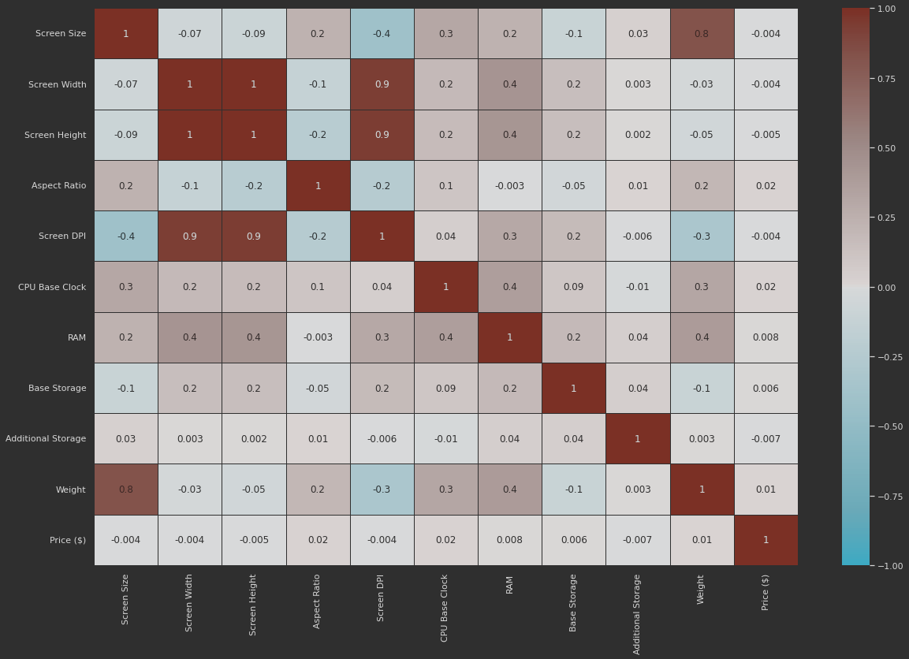
Data Exploration Correlation Matrix
Singapore Polytechnic
As we can see from the Correlation Matrix:
Screen Height and Screen Width are correlated
There is also a very strong correlation between Screen Width & Height and Screen DPI. This is expected because the parameters used to calculate Screen DPI stem from the height and width of the screen
Screen Size and Weight of laptop are also correlated. This correlation is natural due to the increase in construction materials required to manufacture a bigger laptop
Singapore Polytechnic

Slide 14
03.
Modelling & Tuning
Singapore Polytechnic
Baseline, Initial Modelling and Hyperparameter Tuning
Singapore Polytechnic

Slide 15
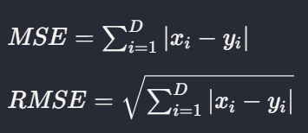
Evaluation Metrics
Singapore Polytechnic
Mean Squared Error (MSE) & Root Mean Squared Error (RMSE)
Take the difference between your model’s predictions and test values, square it, and average it out across the whole dataset.
Advantage: MSE is great for ensuring that our trained model has no outlier predictions with huge errors, since the MSE puts larger weight on these errors due to the squaring part of the function.
Disadvantage: If our model makes a single very bad prediction, the squaring part of the function magnifies the error. Yet in many practical cases we don’t care much about these outliers and are aiming for more of a well-rounded model that performs good enough on the majority.
(Seif, 2022)
Singapore Polytechnic

Slide 16
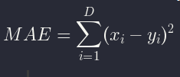
Evaluation Metrics
Singapore Polytechnic
Mean Absolute Error (MAE)
Take the difference between your model’s predictions and test values, apply the absolute value to that difference, and then average it out across the whole dataset, thus providing a generic and even measure of how well our model is performing
Advantage: Since we are taking the absolute value, all the errors will be weighed on the same linear scale. Thus, unlike the MSE, we won’t be putting too much weight on our outliers and our loss function provides a generic and even measure of how well our model is performing.
Disadvantage: If we care about the outlier predictions of our model, then the MAE won’t be as effective. The large errors coming from the outliers end up being weighted the exact same as lower errors. This might result in our model being great most of the time, but making a few very poor predictions every so-often.
Singapore Polytechnic

Slide 17
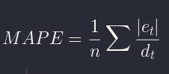
Evaluation Metrics
Singapore Polytechnic
Mean Absolute Percentage Error (MAPE)
MAPE is the sum of the individual absolute errors divided by the demand (each period separately). It is the average of the percentage errors.
Advantage: The absolute values keep the positive and negative errors from cancelling out each other and because relative errors do not depend on the scale of the dependent variable, this measure lets you compare forecast accuracy between differently scaled time-series data.
Disadvantage: MAPE, as a percentage, only makes sense for values where divisions and ratios make sense, and model fitting relies on minimizing errors, which is often done using numerical optimizers that use first or second derivatives. MAPE is not everywhere differentiable, and its Hessian is zero wherever it is defined. This can throw optimizers off if we want to use MAPE as an in-sample fit criterion.
(docs.oracle.com, n.d.) (Vandeput, 2021)
Singapore Polytechnic

Slide 18
Models Used
Singapore Polytechnic
Baseline Model
k-Nearest Neighbours (kNN)
Support Vector Machine (SVM)
Linear Regression
Gradient Boosting
Random Forest
Decision Tree
Singapore Polytechnic

Slide 19
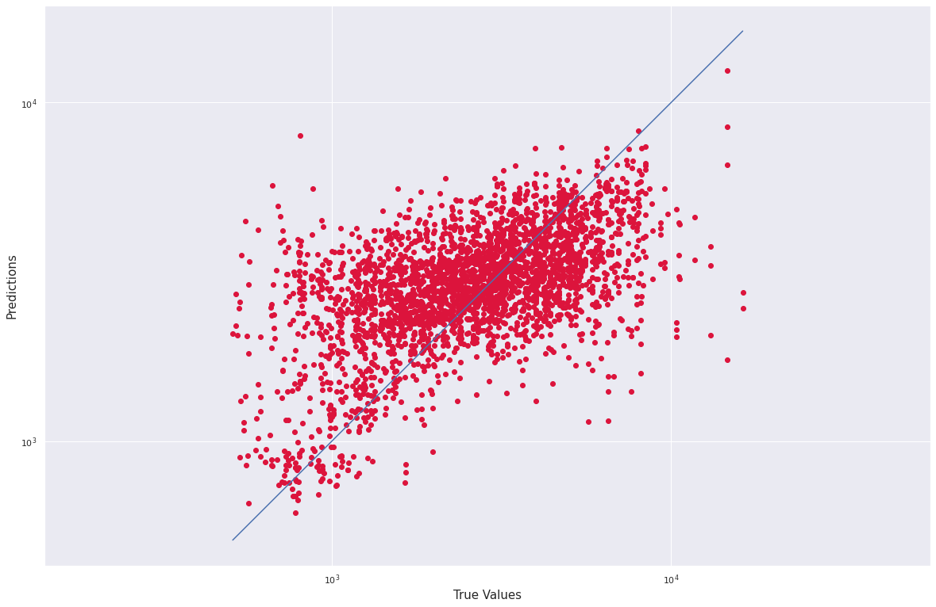
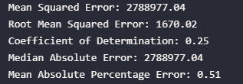
kNN Regressor
Singapore Polytechnic
During initial modelling we observed that this Gradient Boosting model produced:
Mean Squared Error: 2788977.04
Root Mean Squared Error: 1670.02
Coefficient of Determination: 0.25
Median Absolute Error:2788977.04
Mean Absolute Percentage Error: 0.51
This means that the model is able to predict the PC Price with +- $1670 accuracy, with a coefficient of determination of 0.62, meaning that our model is able to explain only 25% of the variance in our response variable.
Therefore, we can conclude that our model performs badly when faced with unseen test data.
Singapore Polytechnic

Slide 20
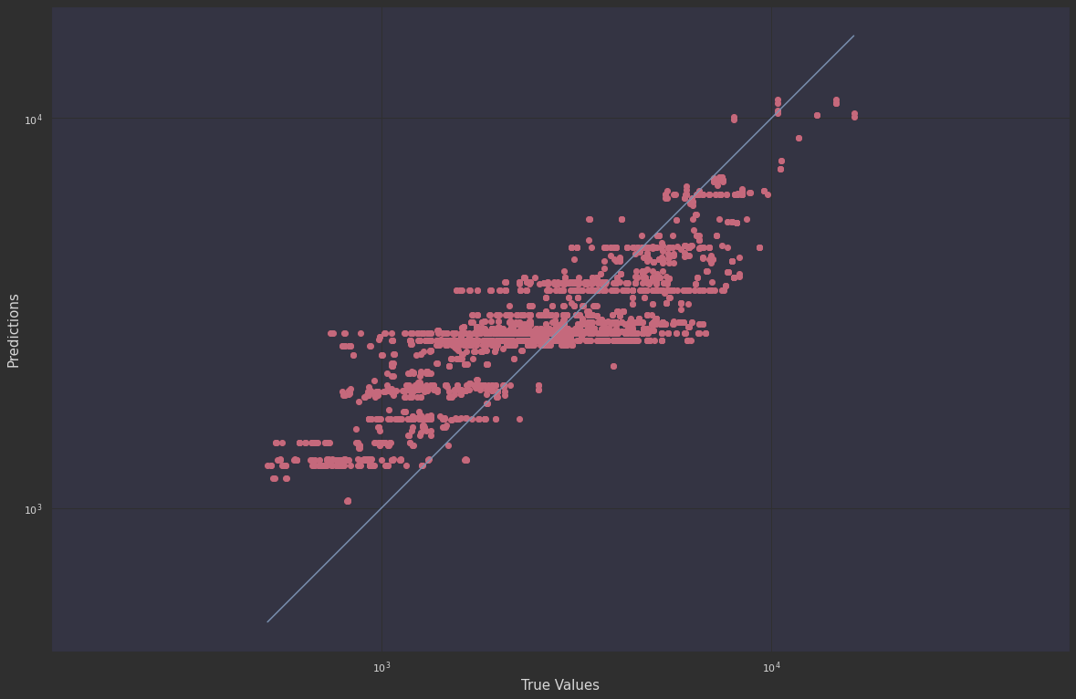
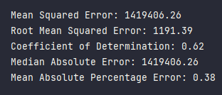
Gradient Boosting
Singapore Polytechnic
During initial modelling we observed that this Gradient Boosting model produced:
Mean Squared Error: 1419406.26
Root Mean Squared Error: 1191.39
Coefficient of Determination: 0.62
Median Absolute Error: 1419406026
Mean Absolute Percentage Error:0.38
This means that the model is able to predict the PC Price with +- $1191 accuracy, with a coefficient of determination of 0.62, meaning that our model is able to explain 62% of the variance in our response variable.
Therefore, we can conclude that our model performs relatively average when faced with unseen test data.

Slide 21
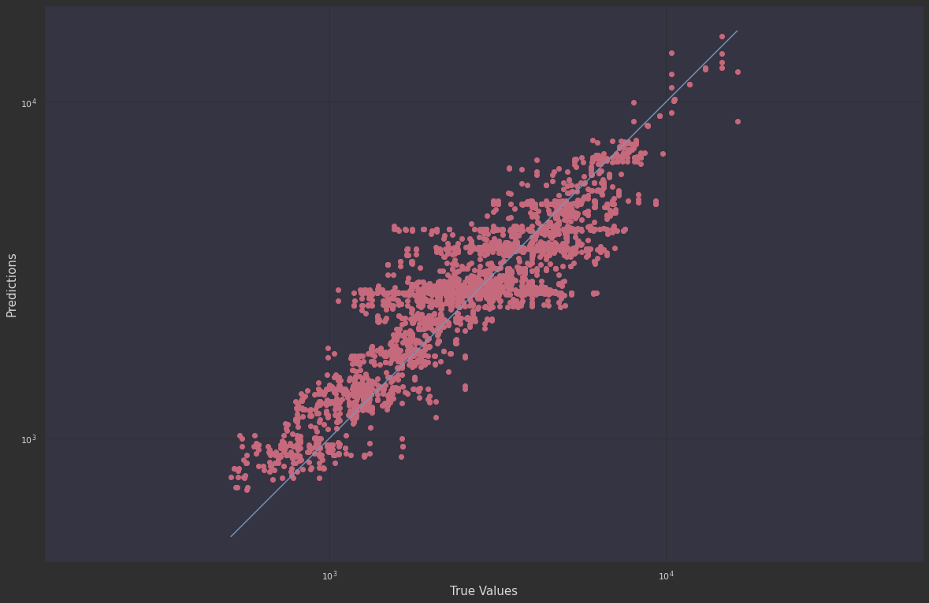
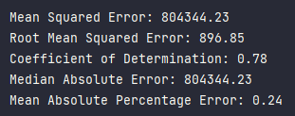
Gradient Boosting (Hyperparameter Tuned)
Singapore Polytechnic
During hyperparameter tuning we observed that the best model was Gradient Boosting, with:
Mean Squared Error: 791994.25
Root Mean Squared Error: 889.94
Coefficient of Determination: 0.79
Median Absolute Error: 791994.25
Mean Absolute Percentage Error: 0.23
This means that the model is able to predict the PC Price with +- $890 accuracy, with a coefficient of determination of 0.79, meaning that our model is able to explain about 80% of the variance in our response variable.
Therefore, we can conclude that our model performs relatively average when faced with unseen test data.
Singapore Polytechnic

Slide 22
04.
Conclusion
Singapore Polytechnic
Conclusion of Insights
Singapore Polytechnic

Slide 23
Conclusion
Singapore Polytechnic
During hyperparameter tuning we observed that the best model was Gradient Boosting, with:
Mean Squared Error: 791994.25
Root Mean Squared Error: 889.94
Coefficient of Determination: 0.79
Median Absolute Error: 791994.25
Mean Absolute Percentage Error: 0.23
This means that the model is able to predict the PC Price with +- $890 accuracy, with a coefficient of determination of 0.79, meaning that our model is able to explain 79% of the variance in our response variable.
Therefore, we can conclude that our model performs relatively average when faced with unseen test data.
Singapore Polytechnic

Slide 24
Singapore Polytechnic
Citations
Patel, H. (2021). What is Feature Engineering — Importance, Tools and Techniques for Machine Learning. [online] Medium. Available at: https://towardsdatascience.com/what-is-feature-engineering-importance-tools-and-techniques-for-machine-learning-2080b0269f10#:~:text=Feature%20Engineering%20is%20a%20very [Accessed 17 Jun. 2022].
Tableau. (n.d.). Data cleaning: The benefits and steps to creating and using clean data. [online] Available at: https://www.tableau.com/learn/articles/what-is-data-cleaning#:~:text=Data%20cleaning%20is%20the%20process [Accessed 17 Jun. 2022].
Seif, G. (2022). Understanding the 3 most common loss functions for Machine Learning Regression. [online] Medium. Available at: https://towardsdatascience.com/understanding-the-3-most-common-loss-functions-for-machine-learning-regression-23e0ef3e14d3#:~:text=The%20Mean%20Squared%20Error%20(MSE [Accessed 15 Jun. 2022]
Nair, A. (2022). Baseline Models: Your Guide For Model Building. [online] Medium. Available at: https://towardsdatascience.com/baseline-models-your-guide-for-model-building-1ec3aa244b8d [Accessed 15 Jun. 2022]
Brownlee, J. (2020). Train-Test Split for Evaluating Machine Learning Algorithms. [online] Machine Learning Mastery. Available at: https://machinelearningmastery.com/train-test-split-for-evaluating-machine-learning-algorithms/ [Accessed 15 Jun. 2022].
Verma, Y. (2021). Why Data Scaling is important in Machine Learning & How to effectively do it. [online] Analytics India Magazine. Available at: https://analyticsindiamag.com/why-data-scaling-is-important-in-machine-learning-how-to-effectively-do-it/#:~:text=Scaling%20the%20target%20value%20is [Accessed 15 Jun. 2022]
Fawcett, A. (2021). Data Science in 5 Minutes: What is One Hot Encoding? [online] Educative: Interactive Courses for Software Developers. Available at: https://www.educative.io/blog/one-hot-encoding [Accessed 15 Jun. 2022]
Vandeput, N. (2021). Forecast KPI: RMSE, MAE, MAPE & Bias. [online] Medium. Available at: https://towardsdatascience.com/forecast-kpi-rmse-mae-mape-bias-cdc5703d242d [Accessed 15 Jun. 2022]
www.southampton.ac.uk. (n.d.). Chi Square | Practical Applications of Statistics in the Social Sciences | University of Southampton. [online] Available at: https://www.southampton.ac.uk/passs/full_time_education/bivariate_analysis/chi_square.page#:~:text=A%20chi%2Dsquare%20test%20is [Accessed 14 Jun. 2022]
Singapore Polytechnic

Slide 25
Thanks!
Singapore Polytechnic
Do you have any questions?
youremail@freepik.com
+91 620 421 838
yourcompany.com
Please keep this slide for attribution
Singapore Polytechnic

